Slide 1


SheWell Hub
"Empowering Women, Nurturing Wellness: Your Trusted Companion in Women's Health Journey"

Slide 2



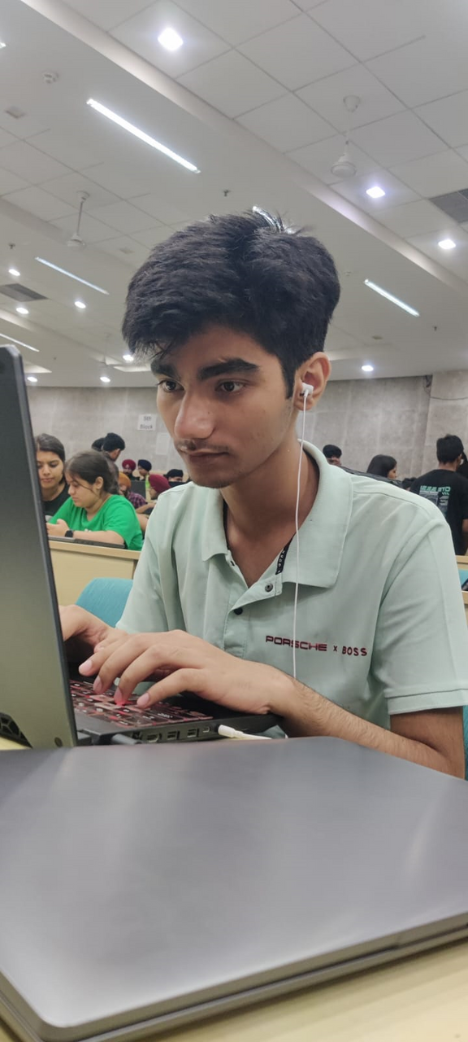

MEET THE AVENGERS!!
SNEHA SINGH
TANISHKA MISHRA
PARICHAY MAGO
JATIN KATARIA

Slide 3
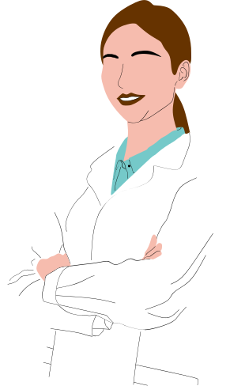
~Women’s Health In Rural Areas~
With the advent of digital platforms and increased connectivity, there's a transformative shift in how women access and engage with healthcare information. In these rural landscapes, where traditional barriers to healthcare persist, technology becomes a potent catalyst for change. Our efforts are aligned with this vision, providing women in rural areas a dedicated space on the web to access vital information about their health, with a particular emphasis on the menstrual cycle. Through innovative features, we aim to bridge the gap in healthcare accessibility, offering not just knowledge but practical solutions and support.

Slide 4
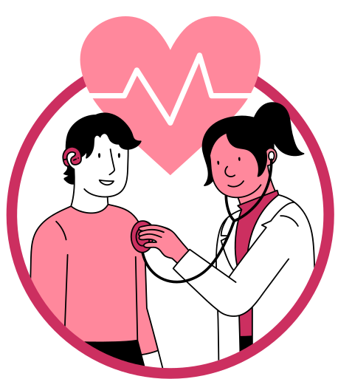
~KEY FEATURES~
Monthly Period Tracker:
Personalized Insights, Predictive Support,Accessibility
Unified Patient Treatment Platform:
Comprehensive Healthcare Overview, Streamlined Communication, Enhanced Care Coordination
Interactive Forum:
Shared Experiences,Connection and Empathy, Holistic Well-Being

Slide 5

~TECHNOLOGIES USED~
INTRODUCING A SINGULAR, UNIVERSAL DATABASEACCESSIBLE ACROSS ALL HOSPITALS, HOUSINGCOMPREHENSIVE PATIENT DETAILS AND MEDICALRECORDS.
Our login credentials boast top-tier securitythrough blockchain encryption, ensuring dataintegrity.
Patients receive a unique ID for streamlinedaccess to their complete information.
Ourmission is solely focused on your well-being.
Powered by AWS EC2 bucket on the backendand Adorned with a user-friendly JavaScriptfrontend, our system seamlessly combinesrobust technology with a commitment toyour optimal health.

Slide 6

~ AI CHATBOT~
STEP INTO THE FUTURE OF SEAMLESS COMMUNICATION WITH OUR AI CHATBOT—AN INNOVATIVE SOLUTION DESIGNED TO REVOLUTIONIZE YOUR INTERACTIONS AND STREAMLINE YOUR DIGITAL EXPERIENCE. SEAMLESSLY BRIDGING THE GAP BETWEEN TECHNOLOGY AND PATIENT CARE, OUR CHATBOT IS YOUR VIRTUALCOMPANION ON THIS DIGITAL HEALTH JOURNEY.
INSTANTLY ACCESSIBLE AND INTUITIVELY DESIGNED, OUR CHATBOTSTANDS READY TO ASSIST USERS IN NAVIGATING THEIR EHR,RETRIEVING MEDICAL INFORMATION, SCHEDULING APPOINTMENTS,AND ANSWERING QUERIES. WITH THE POWER OF ARTIFICIAL INTELLIGENCE, IT LEARNS AND ADAPTS TO USER PREFERENCES,PROVIDING A PERSONALIZED AND EFFICIENT EXPERIENCE.

Slide 7
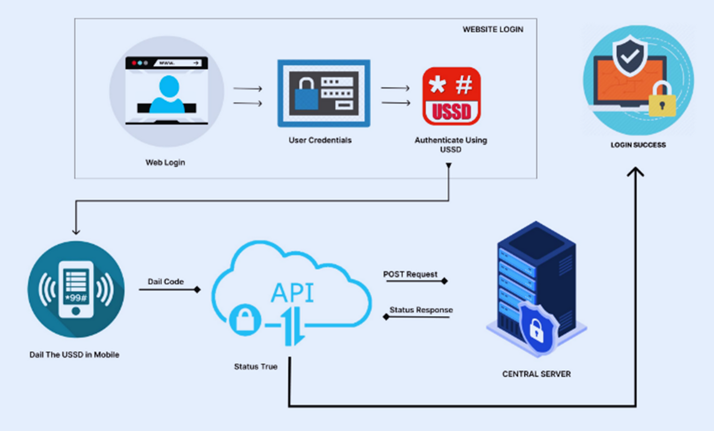
~ARCHITECTURE~

Slide 8

~AWS SERVER-SIDE ENCRYPTION~
Amazon S3 encrypts objects both when saving them on disks in AWS datacenters and when decrypting them upon download.
All Amazon S3 buckets come with encryption configured by default.
New objects uploaded to an S3 bucket are automatically encrypted atrest.
The default encryption configuration for every bucket in Amazon S3 isServer-side encryption with Amazon S3 managed keys (SSE-S3).
To use a different type of encryption, you can specify the encryption typein S3 PUT requests or set the default encryption configuration for thedestination bucket.
AWS provides resources to help protect critical systems and sensitive dataagainst ransomware.
These resources assist in preparing an organization for a ransomwareincident, building a response strategy, and facilitating quicker recoveryfrom such an event.
AWS and the AWS Partner Network offer proactive measures to reducethe risk of a ransomware event.

Slide 9

~ADVANTAGES~
Accessible Information
Empowerment Through Knowledge
Holistic Health Tracking
Unified Patient Treatment Platform
Community Support and Connection
Privacy and Confidentiality
Technology-Driven Innovation

Slide 10

~GOAL OF INNOVATION~
Our goal in innovation is to pioneer a transformative digital experience for women's health, leveraging the power of our website as a beacon of empowerment. Fueled by a commitment to inclusivity and accessibility, we aim to break down barriers in rural areas, providing a comprehensive platform that not only educates but actively contributes to the well-being of women.
Through continuous technological evolution, our website seeks to redefine the landscape of women's health, making information, support, and resources readily available to every woman, regardless of geographical constraints. Our innovation is not just about a website—it's a dedicated space where innovation meets impact, shaping a healthier and more informed future for women in every corner of the community.

Slide 11

~FUTURE OUTLOOK~
~CARECONNECT~
WHY IT MATTRS?
A game-changer for women's health and well-being. With just a click, this innovative addition connects women in need of sanitary napkins with local assistance within a 100-meter radius
. In areas where access to hygiene products may be limited, this feature becomes a lifeline, fostering a sense of community support. By leveraging technology to bridge gaps, we empower women to help each other in real-time, ensuring that no one has to face menstrual hygiene challenges alone.

Slide 12

~CONCLUSION~
In conclusion, our women's health website is poised to redefine the digital landscape for women's well-being. With the upcoming addition of the innovative CareConnect feature, we aim to transform how women access support, making real-time assistance within a 100-meter radius just a click away. Complementing this, our Monthly Period Tracker ensures personalized menstrual health insights, while the Unified Patient Treatment Platform streamlines healthcare information for a comprehensive overview. The inclusion of a supportive forum creates a vibrant community, where women can connect, share experiences, and find solace in shared journeys. Together, these features symbolize our commitment to empowering women, fostering community, and championing holistic health in every phase of life.

